Slide 1
App Engine
App Engine Goal: Let developer focus on app code
No server to manager, scale up fast, scale down to zero
No patches/update
Traffic splitting
Amazon Elastic Bean Stack
Azure App Service

Slide 2
Cloud Functions
Event driven - Via: Cloud pub/Sub, Cloud Storage, HTTP requests
Scalable pay-as-you-go
Functions as a Service (FaaS)
No servers to provision, manage or upgrade
Auto scaling based on load
AWS Lambda
Azure Functions

Slide 3
Cloud Run
Built on top of Knative
HTTP request to running containers
No limitation of languages, binaries and dependencies
Same developer experience, but on Kubernetes
AWS Fargate
Azure Container

Slide 4
Google Kubernetes Engine
Cluster manager and orchestration system for running Docker containers
Built on Open Source Kubernetes Engine
Fully Managed
Scalable
Private Container Registry
Identity & access management
Amazon EKS (Amazon Elastic Container Service for Kubernetes)
Azure Kubernetes Service (AKS)

Slide 5
Compute Options
Cloud Functions
Event driven
Your Code
App Engine
Web applications
Cloud Run
HTTP req/res workloads
Your Containers
Kubernetes Engine
Containerized applications
Compute Engine
existing systems

Slide 6
Compute Options - Abstraction
Cloud Functions
Event
Function definition
Your Code
App Engine
Code
HTTP requests
Cloud Run
Container runtime contract
Any Language
Your Containers
Kubernetes Engine
What programs?
How are they connected? State?
Compute Engine
Your software, Operating system
CPU, RAM, DISK
Networking, Load balancer

Slide 7
Compute Options - Billing Model
Cloud Functions
Usage
Your Code
App Engine
Usage
Cloud Run
Usage/Resources
Your Containers
Kubernetes Engine
Resources
Compute Engine
Resources

Slide 8
Compute Options - Teams
Cloud Functions
Mostly dev focused
Your Code
App Engine
Mostly dev focused
Cloud Run
Mostly dev focused
Owns build tools and deployment decisions
Your Containers
Kubernetes Engine
Dev Ops, Security work together
Compute Engine
Adaptable to various team structures

Slide 9
Cloud BigTable
NoSQL Database
Can store TBs or PBs of data
Supports Apache Hbase APIs
Amazon DynamoDB
Table Storage

Slide 10
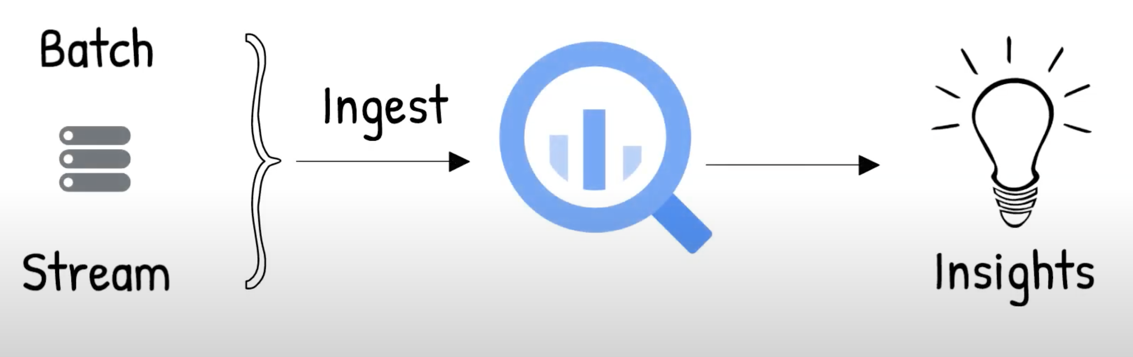
Big Query
Google Cloud Fully managed Enterprise Data warehouse
Data is stored in structured tables
Supports ANSI SQL
Amazon Redshift
Snowflake

